Slide 1

Global CO₂ Emissions Analysis
Roll No. | PRN | Name of Student | Contact No. | Email ID
23 | 1251130298 | Yash Suvarnkar | 7038021322 | yash.1251130298@vit.edu
24 | 1251130207 | Swarali Salunkhe | 9579923611 | swarali.1251130207@vit.edu
25 | 1251130196 | Swayam Chhatre | 8421548272 | swayam.1251130196@vit.edu
26 | 1251130046 | Tanishq Tadas | 7559454261 | tanishq.1251130046@vit.edu
Class: IT Division: F Batch: 2025-26
Project Guide: Prof. Renuka Vaidya

Slide 2

Abstract
This project presents an interactive data analytics dashboard built using Python and Plotly to visualize Global CO2 Emissions data for the years 2018 and 2020. The dataset sourced from Our World in Data covers per-capita CO2 emissions across 190+ countries, categorized by continent and income group. The dashboard features five key visualizations: a bar chart of Top 10 highest emitting countries (led by Qatar at 31.73 Mt), a comparative 2018 vs 2020 bar chart revealing the impact of COVID-19 lockdowns on global emissions (total: 724 Mt in 2020), a donut chart showing continental distribution (Asia: 38.9%, Europe: 31.6%), a bar chart of emissions by income group (High Income nations contributing 421.2 Mt), and a scatter plot analyzing emission change trends. Built with Pandas for data processing and Plotly Dash for the interactive interface, this tool provides a comprehensive, multi-layered story of global carbon footprints, serving as both an educational tool and environmental awareness platform.

Slide 3
Flow Of Program
START
Load CSV Dataset
(carbon_emission.csv via Pandas)
Clean & Filter Data
(Filter by Year, Country, Continent)
Generate Visualizations
(Bar, Pie, Scatter via Plotly)
Display Interactive Dashboard
(Plotly Dash Web App)
END

Slide 4
Features of your Project
Libraries Used:
Pandas - Data loading, cleaning, filtering, and aggregation of the CSV dataset
Plotly Express & Graph Objects - Interactive bar charts, donut charts, and scatter plots
Plotly Dash - Framework to build the interactive web-based dashboard application
NumPy - Numerical operations and array manipulation for data processing
Key Features:
Dark-themed, fully interactive Plotly Dash dashboard interface
5 visualization types: Bar, Comparative Bar, Donut, Income Group Bar, Scatter Plot
Analyzes 190+ countries across 6 continents and 5 income groups
Captures COVID-19 lockdown impact on 2020 global emissions data

Slide 5
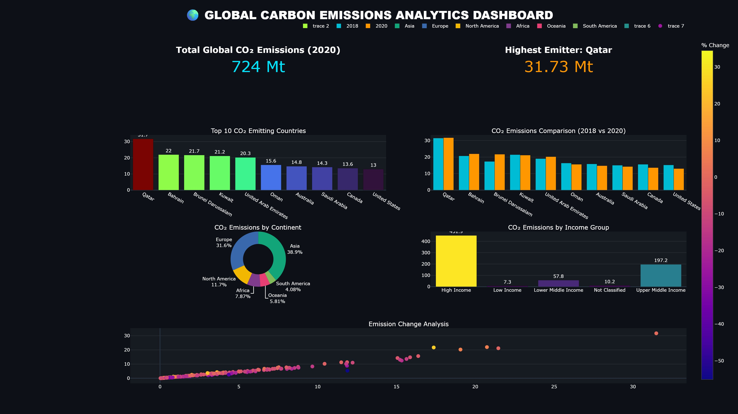
Final Output of Project

Slide 6
Conclusion
Key Findings:
Qatar is the highest per-capita CO2 emitter at 31.73 Mt (2020)
Total global CO2 emissions in 2020 were 724 Mt, showing a COVID-19 dip vs 2018
Asia dominates emissions by continent at 38.9%, followed by Europe at 31.6%
High Income nations account for 421.2 Mt - the largest share by income group
Middle Eastern countries dominate the Top 10 highest emitters list
Future Scope:
Live API Integration: Replace static CSV with World Bank or Our World in Data APIs
ML Predictive Analytics: Use Scikit-Learn to forecast emissions for the next decade
Geographical Choropleth Mapping: 3D interactive world maps with emission intensity gradients
Granular Industrial Sector Breakdown: Isolate energy, transport, agriculture, and data centres

Slide 7
Thank You

